Slide 1

Intro to Programming
Charles Odili

Slide 2
Introduction to Programming
Computer Programming & Languages

Slide 3
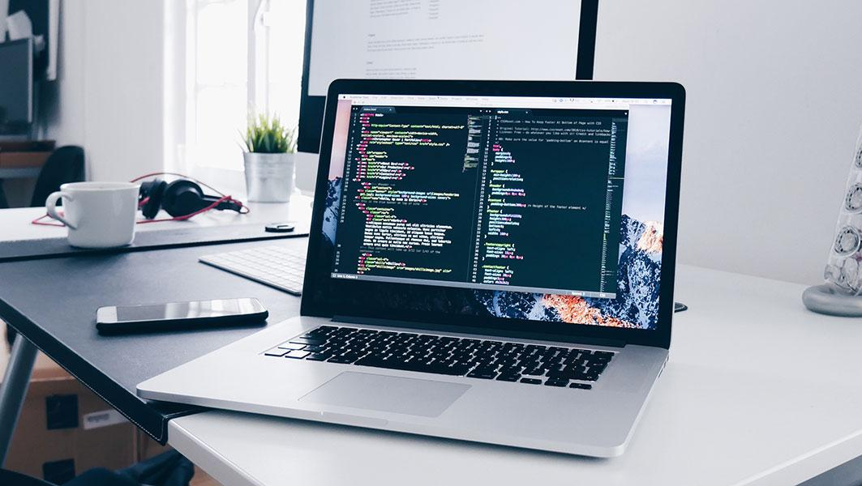

Slide 4
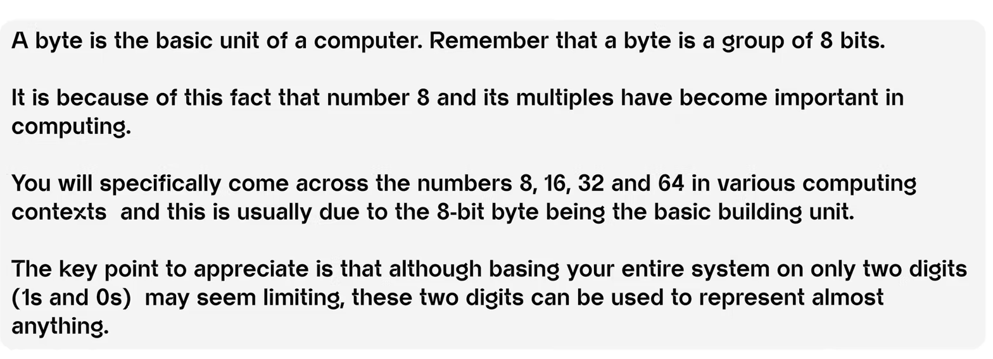
Bits & Bytes

Slide 5
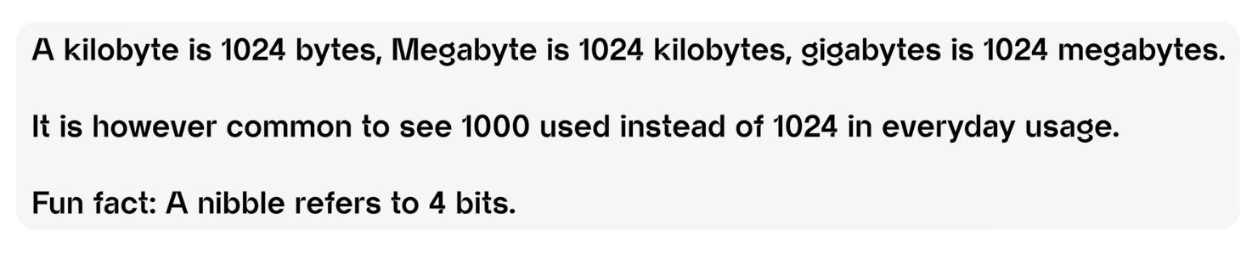
Bits & Bytes

Slide 6
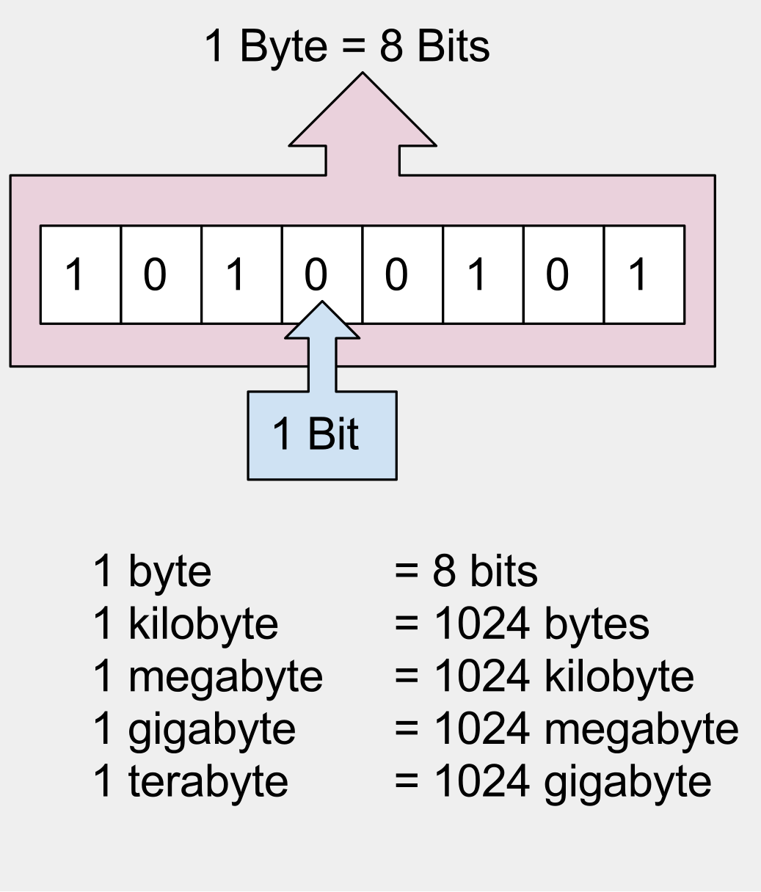
Bits & Bytes

Slide 7
Introduction to Programming
Variables & Data Types

Slide 8
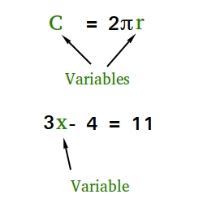

Slide 9
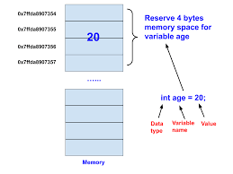

Slide 10
Introduction to Programming
Data Structures

Slide 11
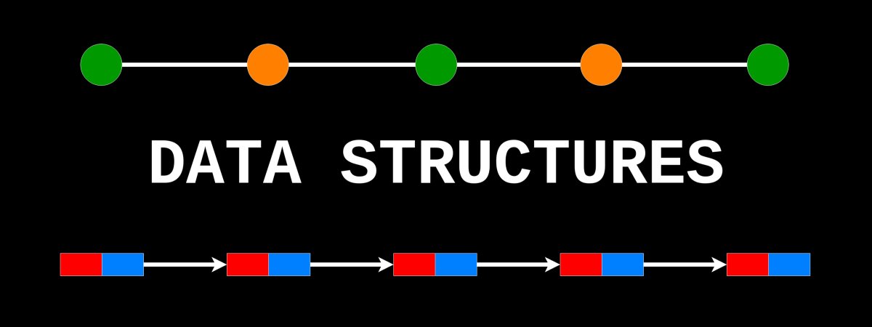

Slide 12
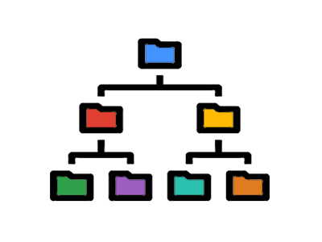
A Tree Data Structure

Slide 13

A Tree Data Structure

Slide 14
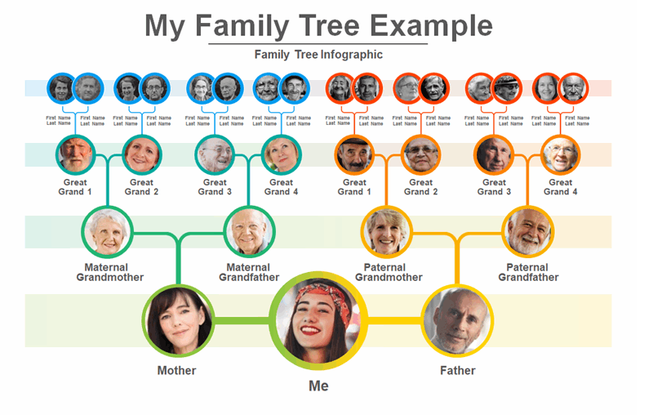
A Tree Data Structure

Slide 15
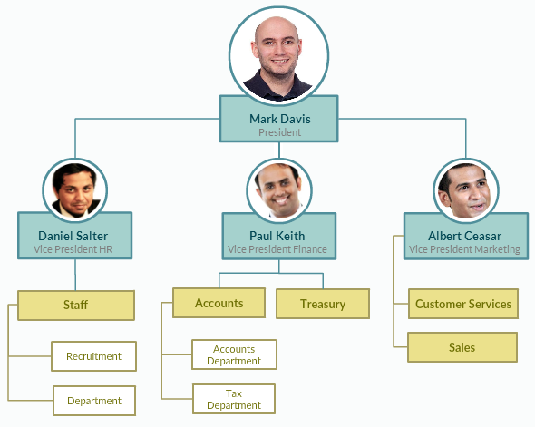
A Tree Data Structure

Slide 16
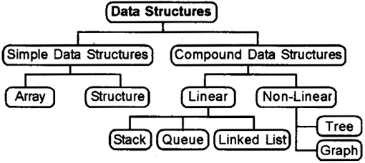

Slide 17
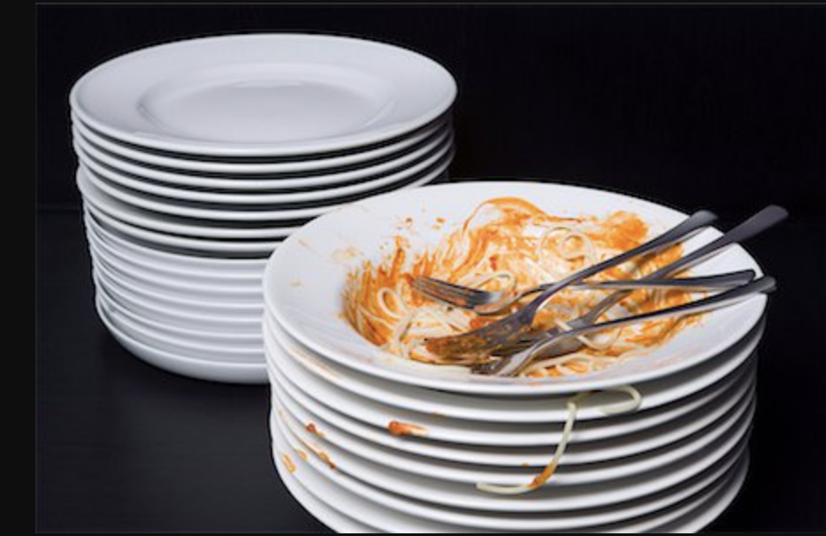
This was at the bottom of the dirty pile, but at the end, it’s now at the top of washed plates
Though this particular plate got added last into the pile by the person gathering dirty plates in a wedding, by the time this pile gets to the kitchen, this very plate will be the first to get picked up, washed and leave the pile. A stack is a last-in-first-out data structure

Slide 18
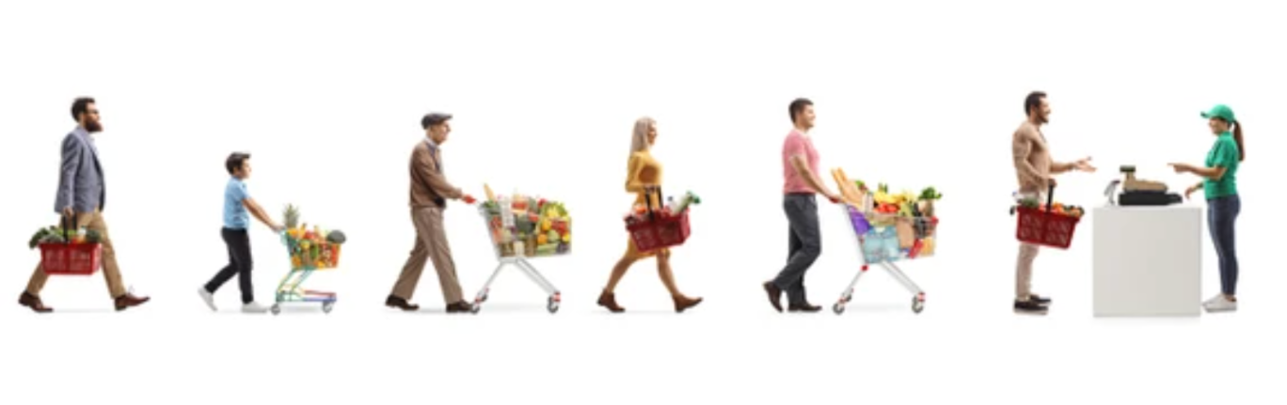
The entire payment process is a queue and people are attended to in the order / sequence in which they entered the line. A queue is a first-in-first-out data structure
He’ll get to the pay point last, so will be the last to pay and exit
He got here first, so he’ll be the first to pay and exit with his goodies

Slide 19
Introduction to Programming
Conditionals, Loops & Recursion

Slide 20
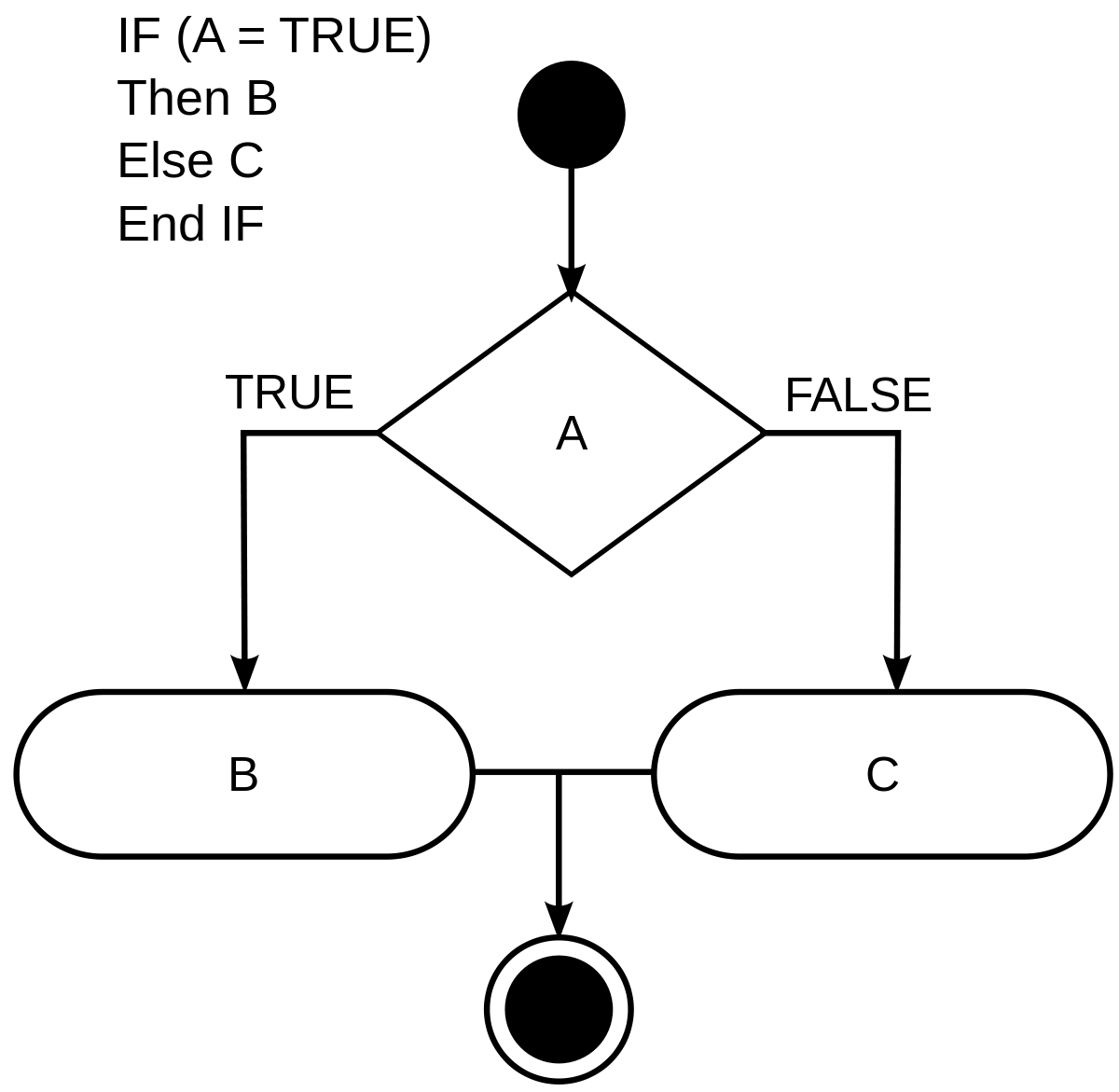

Slide 21
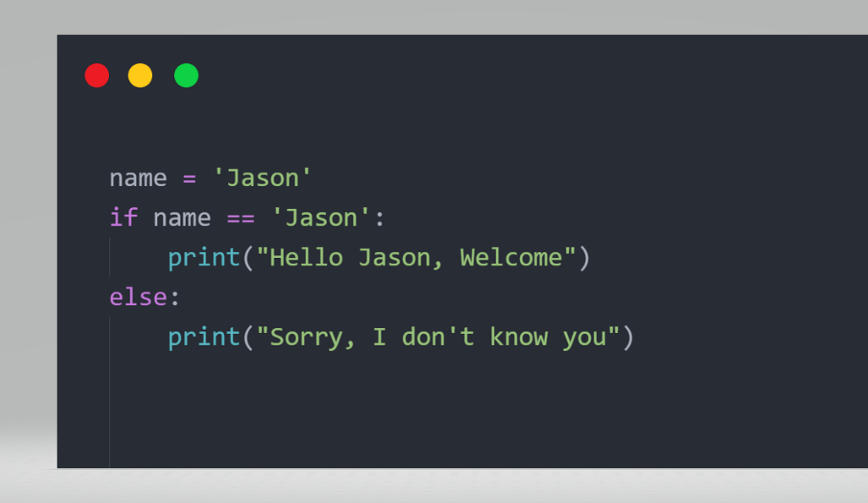

Slide 22


Slide 23
A Loop

Slide 24
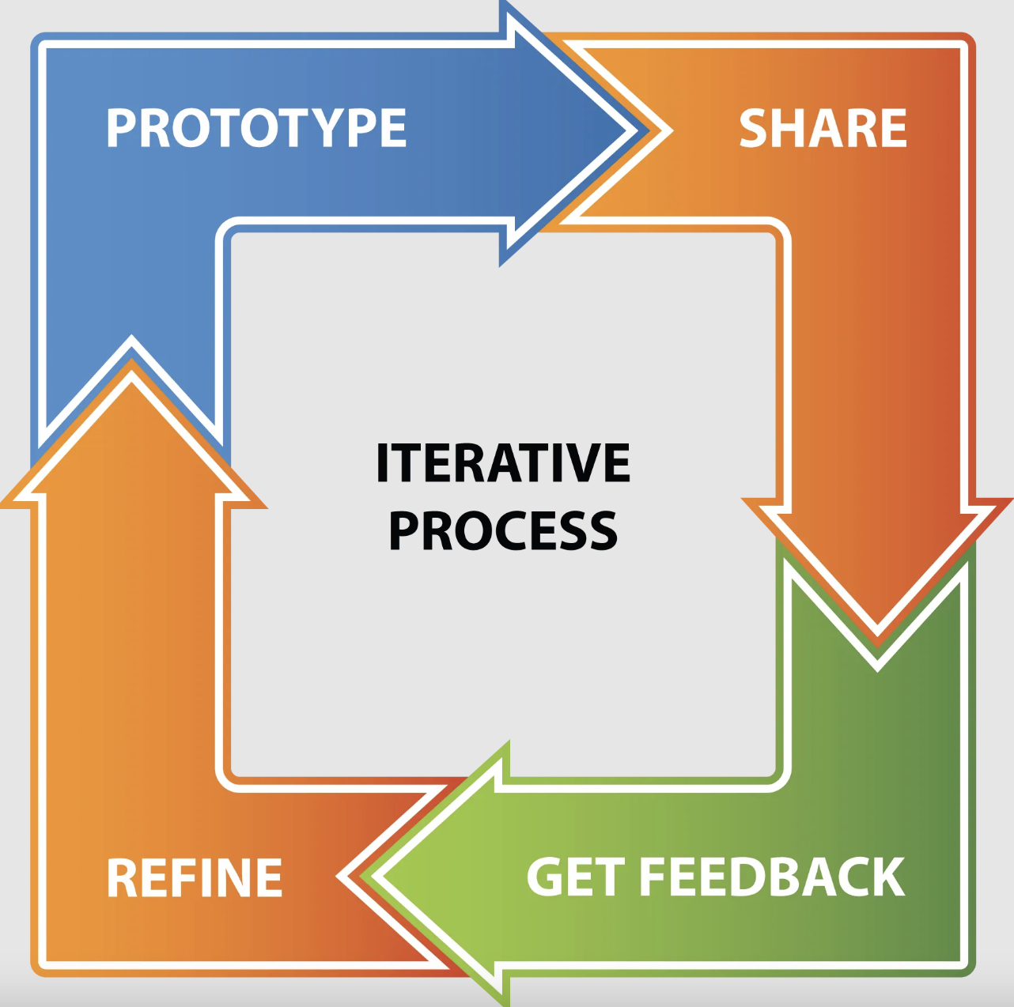

Slide 25
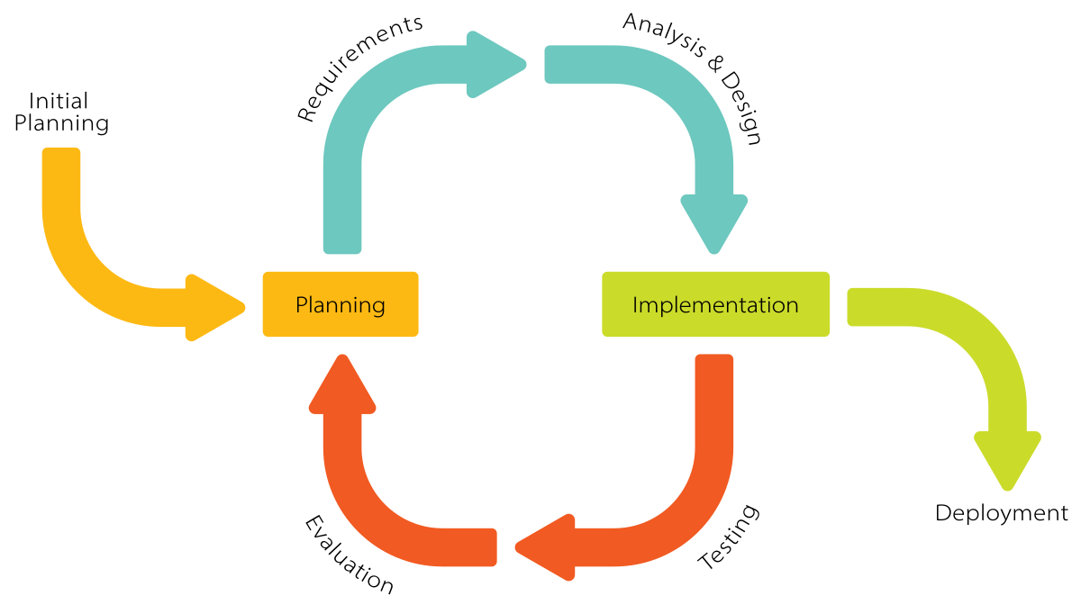

Slide 26
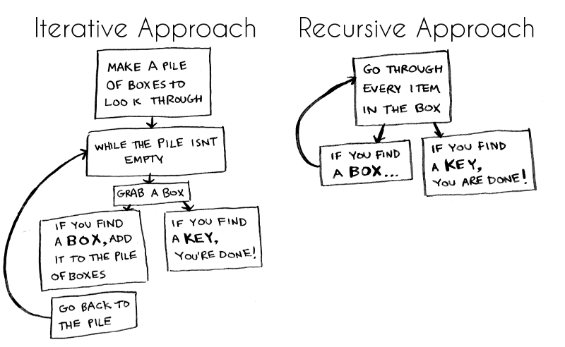

Slide 27
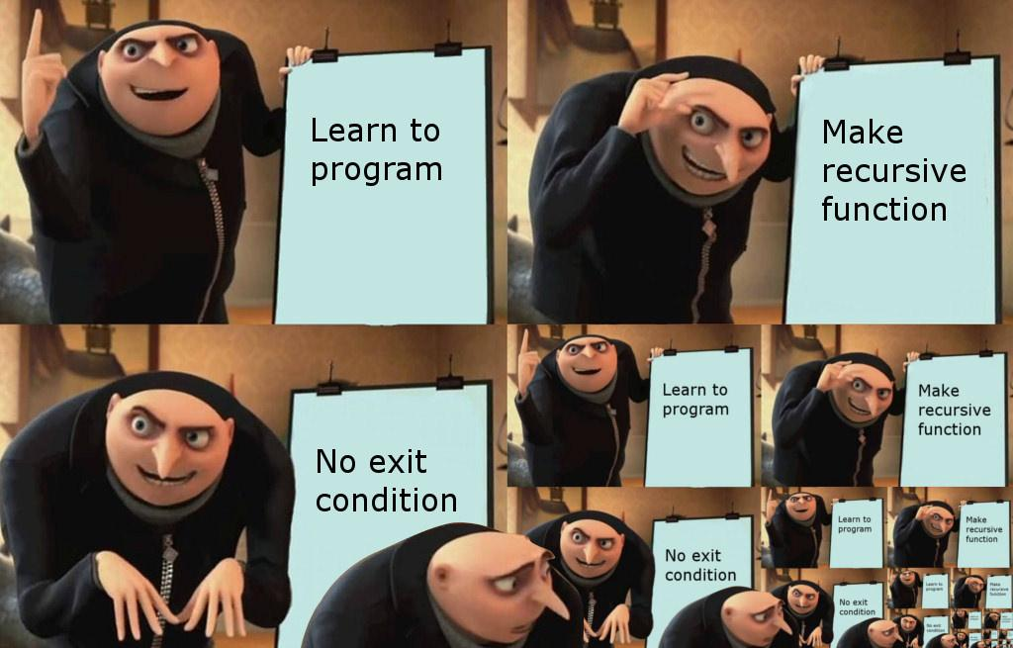

Slide 28


Slide 29
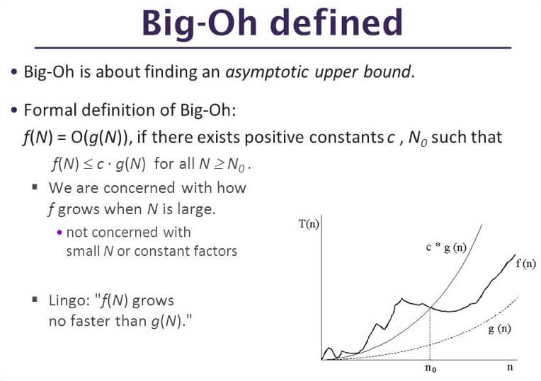

Slide 30


Slide 31
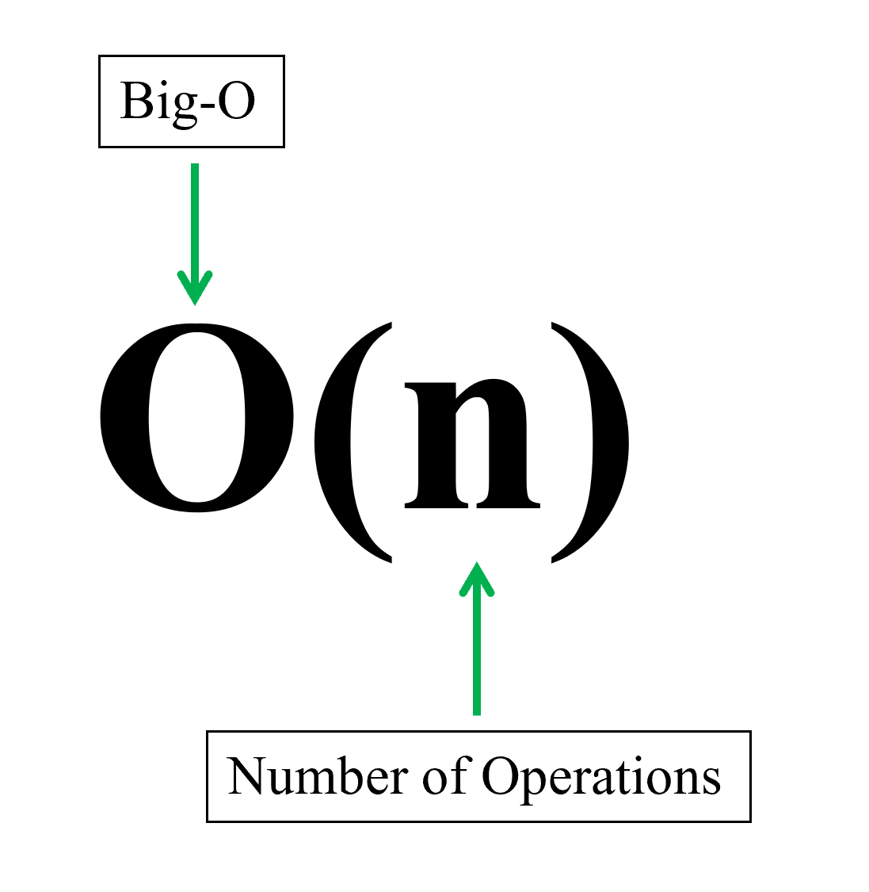
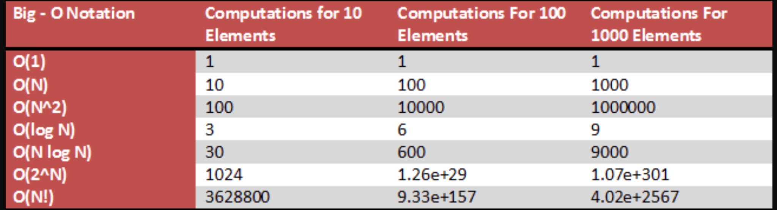

Slide 32
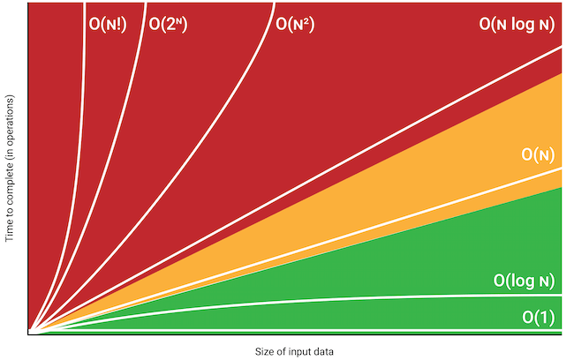

Slide 33


Slide 34
Introduction to Programming
Paradigm: OOP

Slide 35
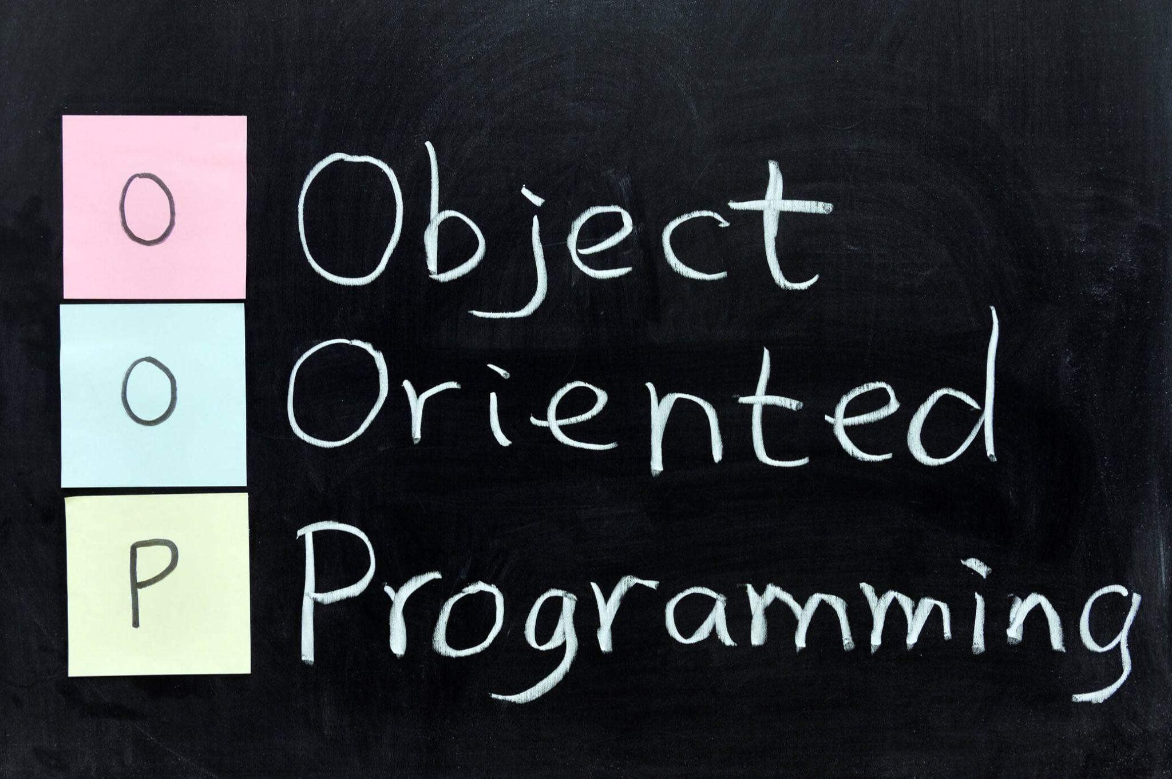

Slide 36
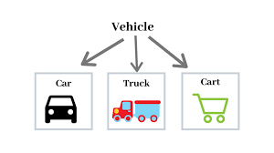
?

Slide 37
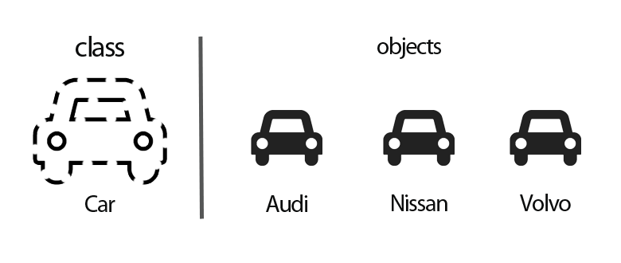
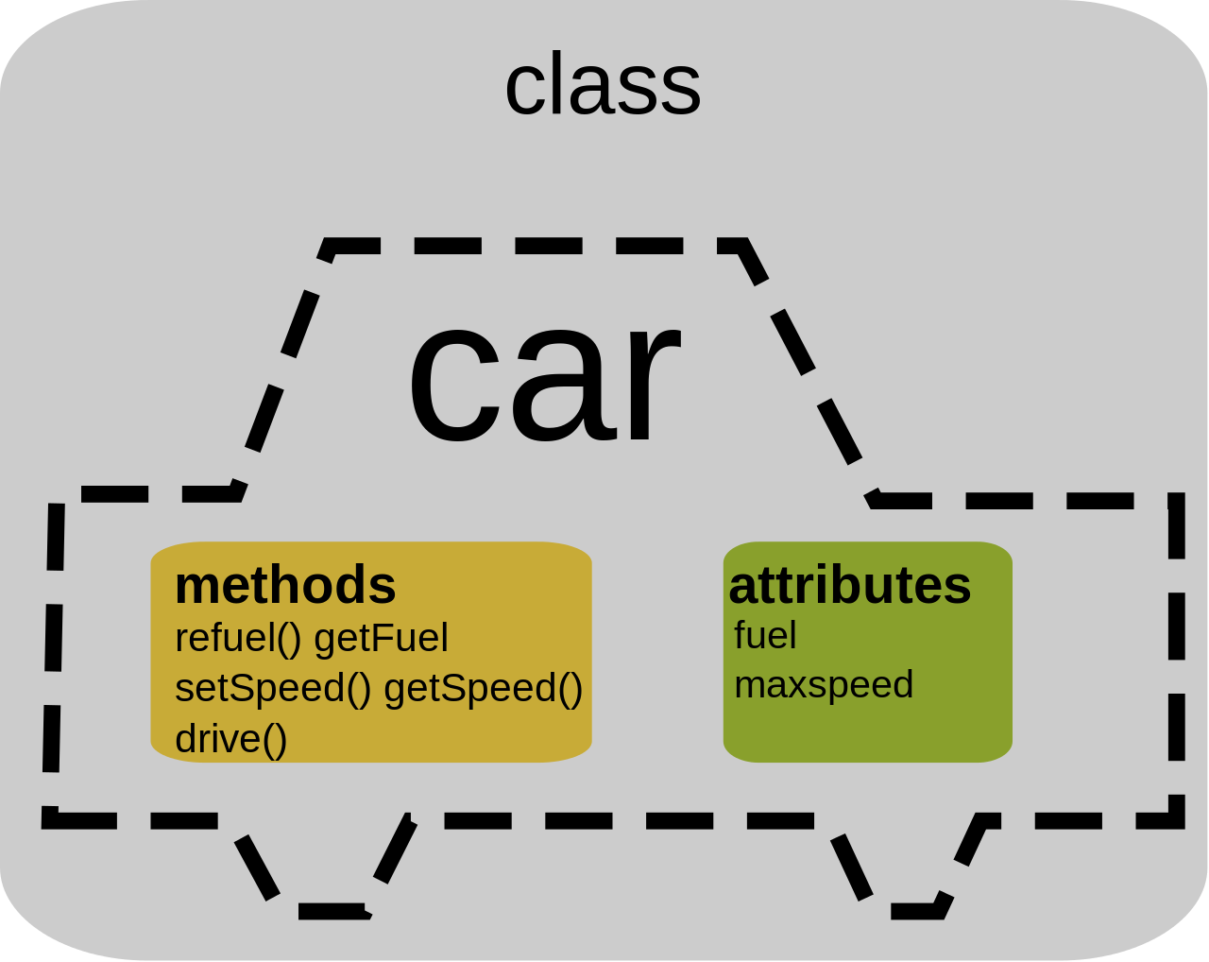

Slide 38
Introduction to Programming
Paradigm: FP

Slide 39
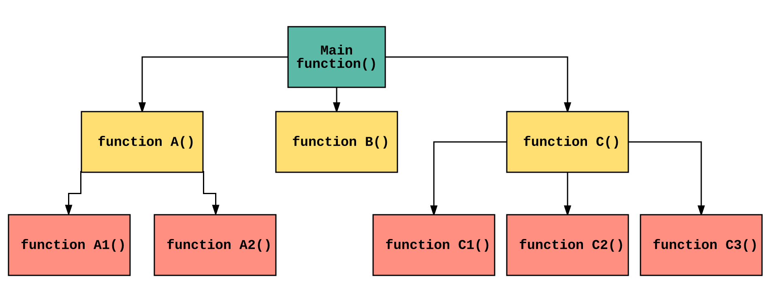

Slide 40
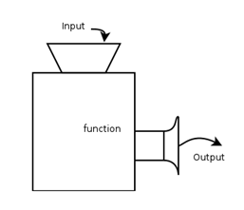

Slide 41
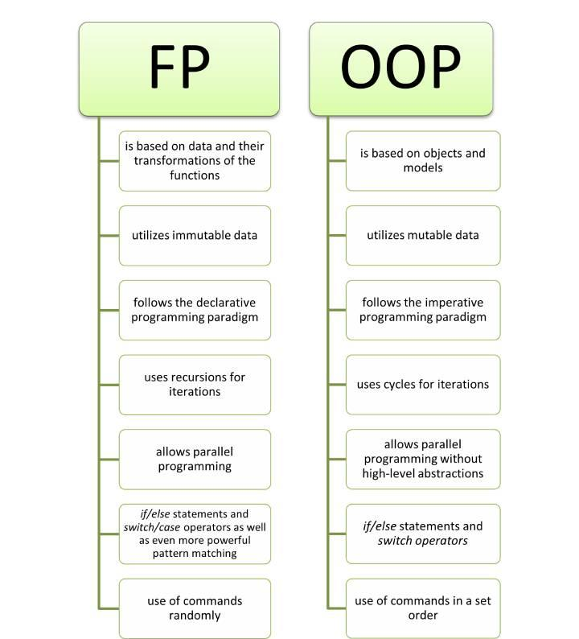

Slide 42
Introduction to Programming
Algorithms

Slide 43
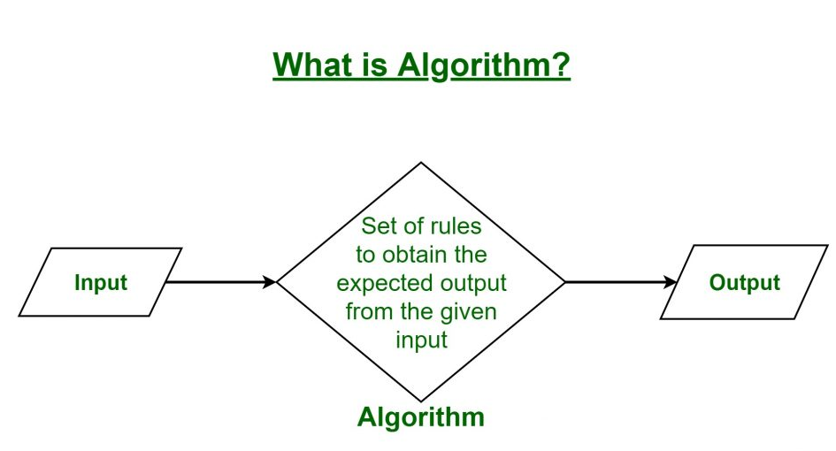

Slide 44
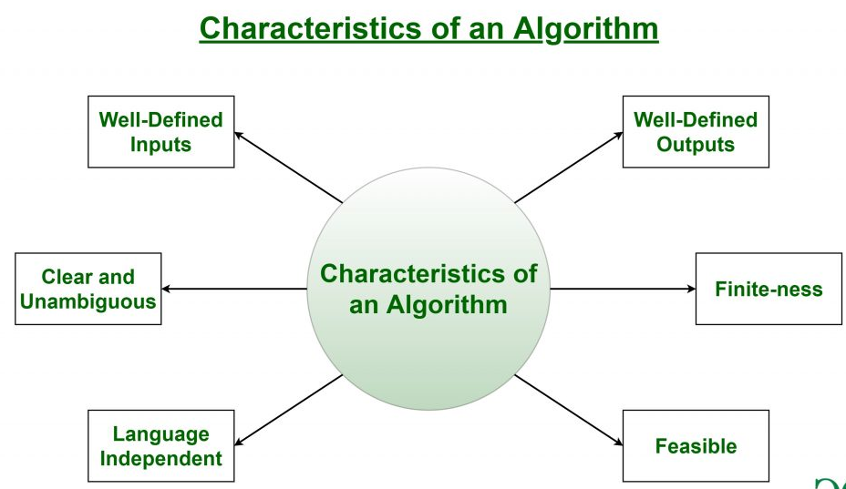

Slide 45
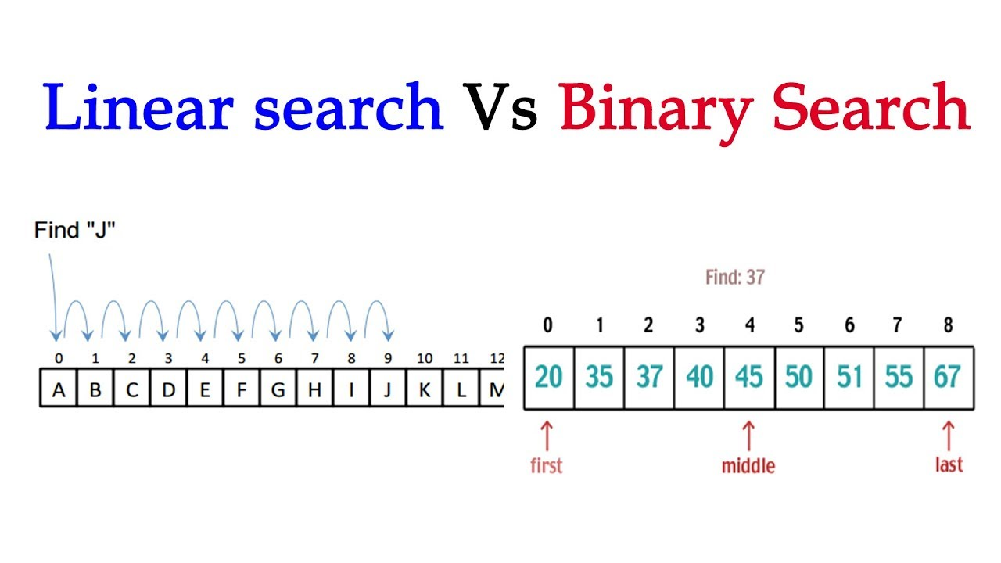

Slide 46
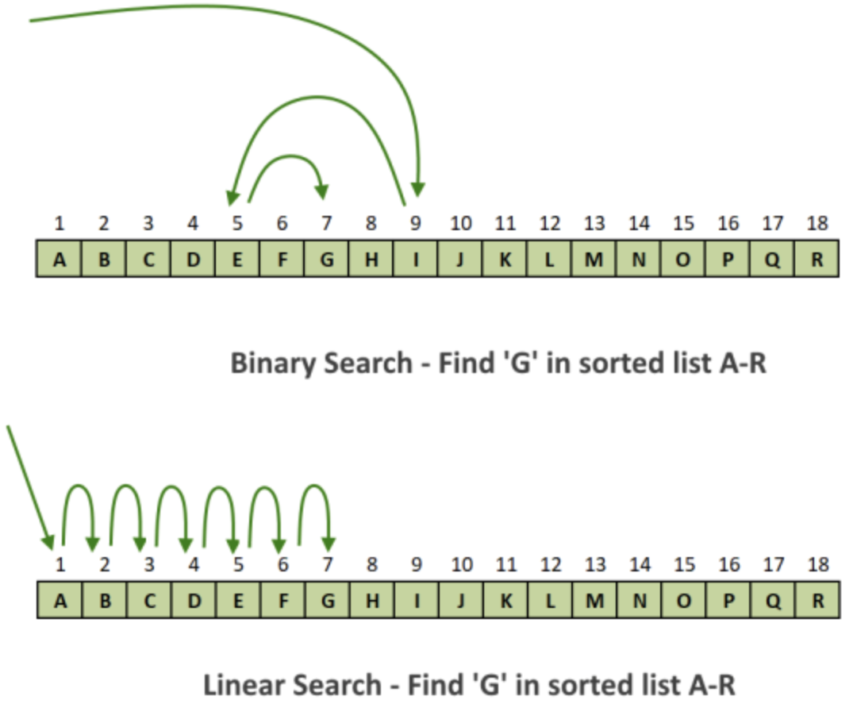

Slide 47
Thank You!

